Slide 1

WEB Development
Grade 7&8

Slide 2
Recap of the last class
Notes:
Objective of the Slide:
Review key concepts learned in the previous class regarding HTML tags and webpage creation.
Instructions for the Teacher:
Briefly recap the topics covered in the last class, emphasizing the use of HTML tags like <html>, <head>, <body>, and <title> for webpage creation.
Encourage students to recall and engage with the material covered in the previous session.

Slide 3



Introduction to <div> and <img> Tags

Slide 4
Sarah went to an Adventure Journy
As Sarah learned how to share her stories online, she wanted to make them easy to find. She thought about splitting up the page and adding some pictures. This would help keep things neat on a webpage.
As Sarah wanted to share her adventurous journey,
Sarah thought, "How can I do this?"
So let's help Sarah in building this webpage to share her adventurous journey
Notes:
Answer : She can use the <div> tag to split up the page, and the <img> tag to add pictures.
Objective of the Slide:
Introduce students to the <div> and <img> HTML tags.
Instructions for the Teacher:
Explain the significance of <div> and <img> tags in webpage design.

Slide 5
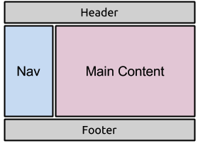
Understanding <div> Tag
Imagine <div> as a big container box that can hold different things, like text, pictures, or even other boxes.
It helps keep everything organized on a webpage, like putting toys into different bins.
Notes:
Objective of the Slide:
Provide an analogy to help students understand the purpose and functionality of the <div> tag.
Instructions for the Teacher:
Use a simple analogy to explain the concept of the <div> tag as a container for organizing content on a webpage.
Encourage students to visualize and conceptualize the <div> tag as a versatile container analogous to bins for organizing items.

Slide 6

Understanding <img> Tag
<img> is like a magic spell to make pictures appear on a webpage. You tell it where the picture is with the "src" part and even describe the picture just in case it doesn't show up (with the "alt" part).
It's like telling a friend about a cool drawing you made, just in case they can't see it.
Notes:
Objective of the Slide:
Explain the purpose and functionality of the <img> tag in HTML for inserting images into webpages.
Instructions for the Teacher:
Use a relatable analogy to illustrate how the <img> tag functions in HTML.
Emphasize the importance of the 'src' and 'alt' attributes in specifying the image source and providing alternative text.

Slide 7
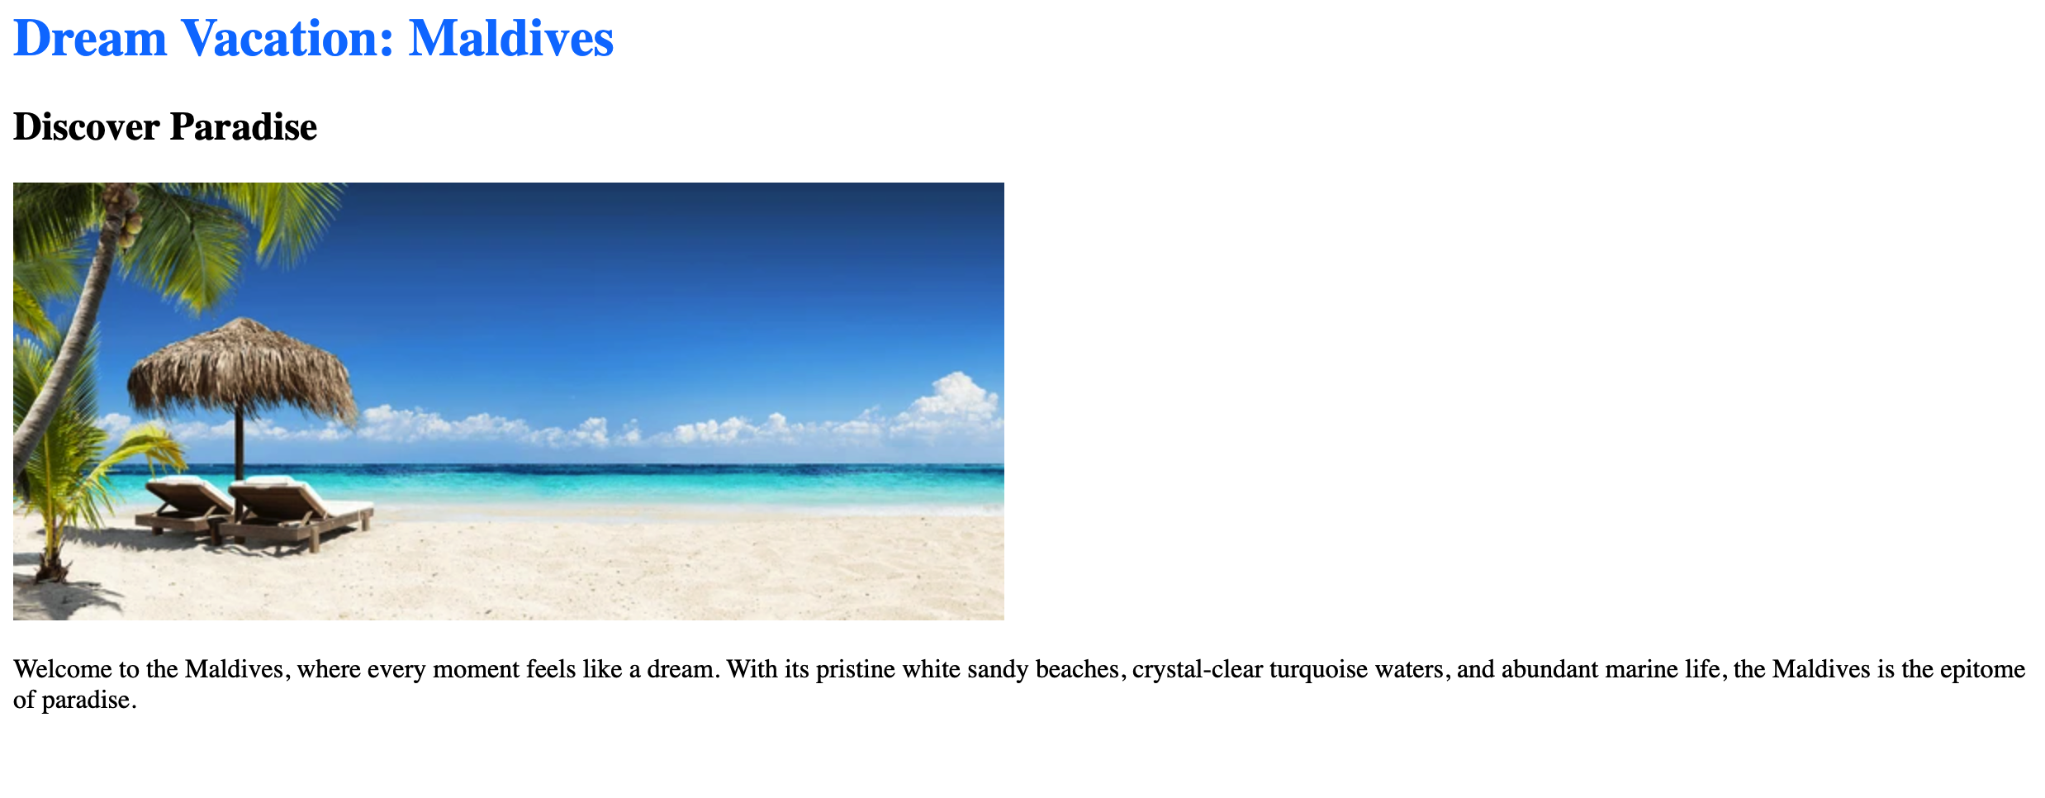
Creating the Project
Notes:
Project link:
https://replit.com/@curriculumsmana/Project-Class-2-G-5and6#index.html

Slide 8
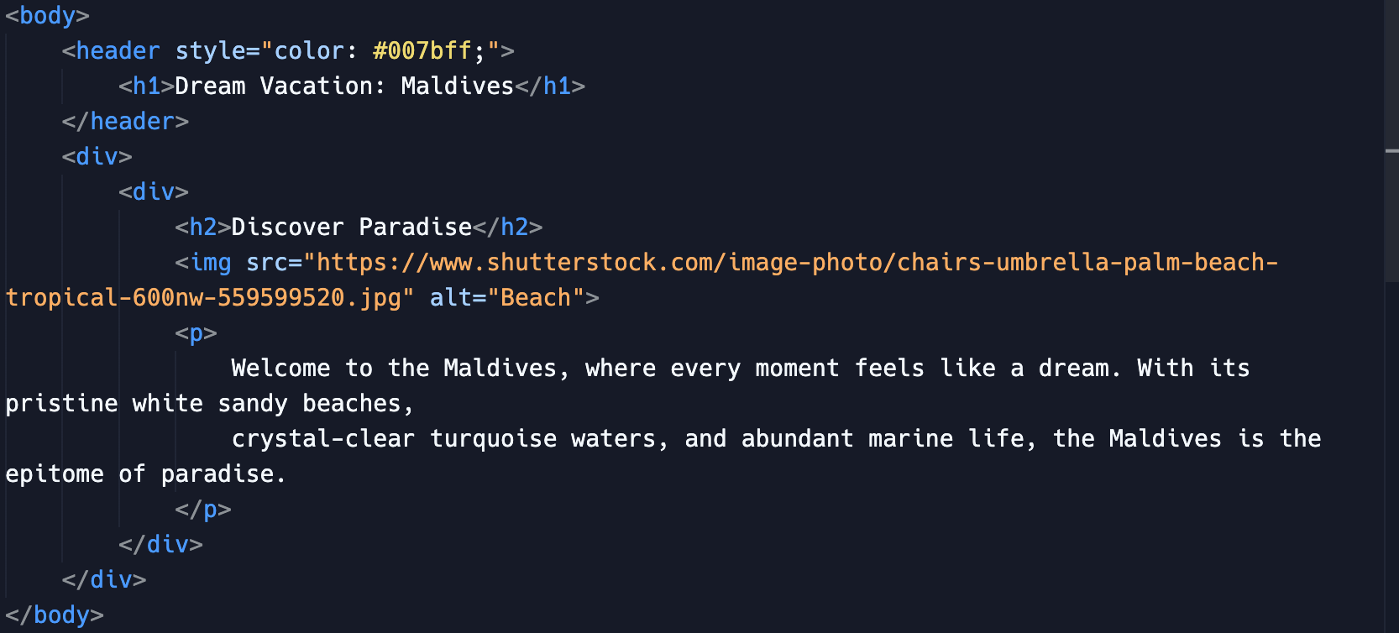
Creating the Project
Notes:
Project link:
https://replit.com/@vijayselfcode/Lesson-2-G-5and6

Slide 9
Let's Explore the Tags
<header style="color: #007bff;">: This tag defines a header section in the webpage. The style attribute is used to apply inline CSS styling to the header element, setting the text color to a shade of blue (#007bff).
<h1>Dream Vacation: Maldives</h1>: This tag represents the main heading of the webpage within the header section, indicating that it is about a dream vacation in the Maldives.
<div>: This tag defines a division or section in the HTML document.
Notes:
"Teacher's Activity"
Instructions for the Teacher:
Explain the HTML Tags used in the project using the provided code snippets.
Use analogies to help students understand the purpose of each HTML element.
Class Activity:
Break down the code snippets and ask students to identify the purpose of each element.

Slide 10
Let's Explore the Tags
<h2>Discover Paradise</h2>: This tag represents a level 2 heading, indicating a section title "Discover Paradise".
<img src="https://www.shutterstock.com/image-photo/chairs-umbrella-palm-beach-tropical-600nw-559599520.jpg" alt="Beach">: This tag inserts an image into the webpage.
The 'src' attribute specifies the URL of the image.
The 'alt' attribute provides alternative text to be displayed in the case of broken image or invalid URL for the image.
<p>: This tag represents a paragraph of text.
Notes:
"Teacher's Activity"
Instructions for the Teacher:
Explain the HTML Tags used in the project using the provided code snippets.
Use analogies to help students understand the purpose of each HTML element.
Class Activity:
Break down the code snippets and ask students to identify the purpose of each element.

Slide 11

It's your turn to Shape it
We've acquired knowledge about employing the div and img tags, as well as altering text color.
Now, it's time to add more pictures and interesting information about New York City or any of your favourite place.
You can also make the text more colorful.
Notes:
"Student's Activity"
Instructions for the Teacher:
Challenge students to apply their knowledge of HTML.
Provide suggestions for the images and places they can choose to add in the continuation of the project.
Class Activity:
Give students time to work on their webpage projects.
Encourage creativity and offer assistance as needed.

Slide 12

How to Save & Share the project.
Replit offers autosave option – so not worry about the same.
To share project with someone in view mode: just copy the link from the URL bar, and share the link
To share the project for collaboration
Click on "Invite" from the top right corner
If you know the username, type it in the box and click on invite
You can also turn on the toggle button "private join link" to create a public collaboration link and invite members to edit your code.
Notes:
Instructions for the Teacher:
Explain how to save and share projects on Replit, including the options for collaboration.
Emphasize the importance of sharing projects for feedback and collaboration.
Class Activity:
Have students save their webpage projects on Replit.
Encourage them to share their projects with classmates for feedback and collaboration.

Slide 13

Hey there! It's Quiz Time
Question 1: What is the primary purpose of the <div> tag in HTML?
A) To display images
B) To create a division or section in a webpage
C) To insert hyperlinks
D) To format text
Notes:
Instructions for the Teacher:
Conduct a quiz to assess students' understanding of the concepts covered in the presentation.
Allow students to answer each question individually before revealing the correct answer.
Use the quiz as an opportunity to reinforce key concepts and address any misconceptions.
Class Activity:
Present each quiz question to the class and allow students time to think about their answers.
Encourage students to discuss their answers with their peers before revealing the correct answer.
Provide explanations for each correct answer to ensure understanding.

Slide 14
Hey there! It's Quiz Time
Question 2: Which attribute of the <img> tag specifies the URL of the image to be displayed?
A) alt
B) src
C) href
D) title
Notes:
Instructions for the Teacher:
Conduct a quiz to assess students' understanding of the concepts covered in the presentation.
Allow students to answer each question individually before revealing the correct answer.
Use the quiz as an opportunity to reinforce key concepts and address any misconceptions.
Class Activity:
Present each quiz question to the class and allow students time to think about their answers.
Encourage students to discuss their answers with their peers before revealing the correct answer.
Provide explanations for each correct answer to ensure understanding.

Slide 15
Hey there! It's Quiz Time
Question 3: In HTML, what does the 'alt' attribute of the <img> tag represent?
A) Alternative text for the image, displayed if the image cannot be loaded
B) Alignment of the image on the webpage
C) Animated transition effect for the image
D) Altitude of the image from the top of the webpage
Notes:
Instructions for the Teacher:
Conduct a quiz to assess students' understanding of the concepts covered in the presentation.
Allow students to answer each question individually before revealing the correct answer.
Use the quiz as an opportunity to reinforce key concepts and address any misconceptions.
Class Activity:
Present each quiz question to the class and allow students time to think about their answers.
Encourage students to discuss their answers with their peers before revealing the correct answer.
Provide explanations for each correct answer to ensure understanding.

Slide 16
Hey there! It's Quiz Time
Question 4: Which of the following is NOT a valid use of the <div> tag in web design?
A) Creating a container for other HTML elements
B) Dividing a webpage into sections for styling or layout purposes
C) Displaying images directly on the webpage
D) Grouping and styling content for better organization
Notes:
Instructions for the Teacher:
Conduct a quiz to assess students' understanding of the concepts covered in the presentation.
Allow students to answer each question individually before revealing the correct answer.
Use the quiz as an opportunity to reinforce key concepts and address any misconceptions.
Class Activity:
Present each quiz question to the class and allow students time to think about their answers.
Encourage students to discuss their answers with their peers before revealing the correct answer.
Provide explanations for each correct answer to ensure understanding.

Slide 17

Let's Wrap it Up – What have we learnt?
What an incredible journey we've had today, young adventurers! We've learned how to use <div> and <img> tags to create our own amazing webpages.
From organizing our content with <div> tags to adding colorful pictures with <img> tags, we've unlocked the secrets of web design together. So, let's celebrate our newfound skills and get ready for even more exciting adventures in the world of web design!
Notes:
Instructions for the Teacher:
Summarize the key points covered in the presentation.
Reinforce the importance of practice and exploration in learning HTML.
Encourage students to continue learning and experimenting with HTML on their own.
Class Activity:
Invite students to share their thoughts and reflections on what they have learned.
Encourage them to ask any remaining questions they may have about HTML.
Remind students of additional resources they can use to further their understanding of HTML.

Slide 18

Homework Discussion
Notes:
Instructions for the Teacher: Facilitate a discussion about the homework assignment.

Slide 19

Extra Marks for Extra Brain
Let's exercise our creativity by designing a webpage that includes images and descriptions of a dream destination or a place you aspire to visit in the future. If you're crafting a tale of magical adventure, think about using headings to organize chapters, paragraphs for storytelling, and images to bring mystical creatures or enchanting scenes to life.

Slide 20

Be mindful of your Behavior
Be kind and respectful online. Avoid cyberbullying and hurtful content.
Jake encountered a classmate being mean to him online, sending hurtful messages.
Instead of responding or retaliating, Jake told his parents, who helped him report the behavior to the school.
The moral of the story: always be kind and respectful online, and inform an adult if someone is being mean to you.

